Slide 1
Assignment Feedback

Slide 2
Feedback
Very impressed!
You understand what you’re doing
Individual writing despite sharing labs
This will help you write your Introductions
Challenge:
Write a one sentence statement of your lab's big idea and your research project. One sentence!

Slide 3
Introduction
You start creating your posters now!

Slide 4
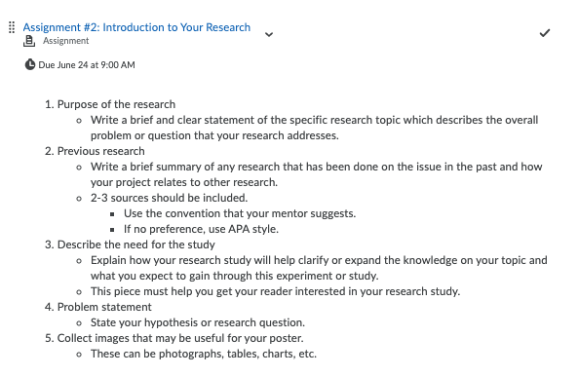
What goes into the Introduction

Slide 5
Watch out for
You want to say so much, less is more
Are you thinking out loud?
Missing the big idea!
Being late

Slide 6
Big Picture Pictionary

Slide 7
Notes on starting your poster materials
Read the assignment requirements NOW
Don’t wait until the night before to ask your lab questions
These are not final products
Your lab will have to approve your final presentation
Get feedback now

Slide 8
Upcoming assignments...
Due Friday
Timesheet
Helper Survey
Reflection #3
Due next week
Assignment #2
Speaker questions -Dr. Anita Koshy!

